Slide 1



Plotting Pt. 2 Subplots
A guide in/for Python
Notes:
Welcome back! In this video, we will continue to discuss plotting, specifically subplots. But first, what is a subplot?
Well, a subplot is a smaller plot within a larger figure. Using the subplots() function from the Matplotlib library, we can create a grid of multiple axes or plots, which is incredibly useful for comparing different plots in a single figure to provide a cohesive visual analysis of related data.

Slide 2


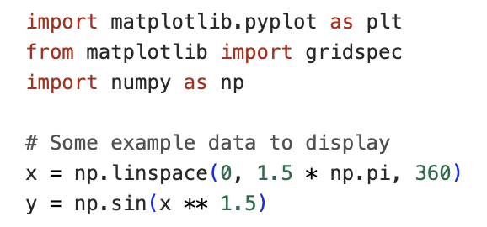
Setting Up
Notes:
But before we go any further, we need to make sure we have imported the appropriate libraries and functions. To plot subplots, we need to import matplotlib, and from matplotlib, we need to import two different plotting functions: pyplot and gridspec.
We also need to create some example data, so we import numpy to help us do this.

Slide 3
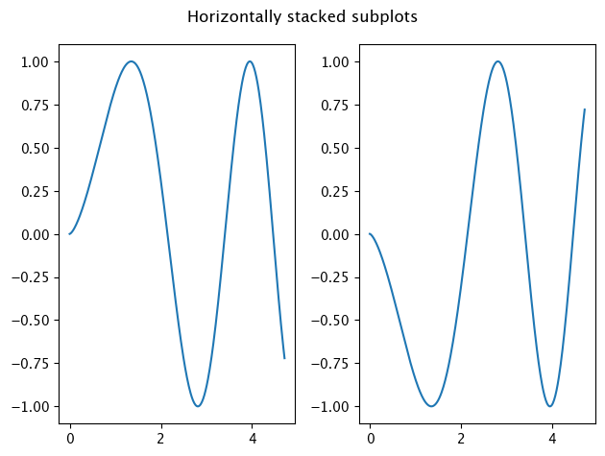
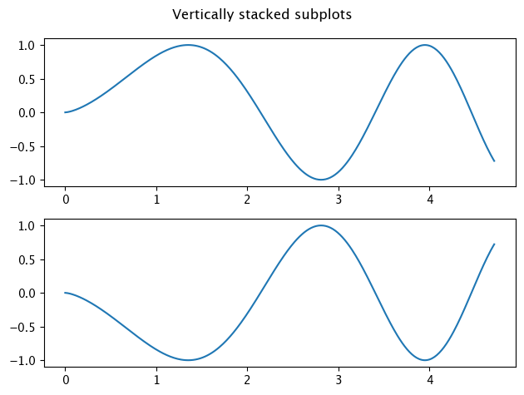
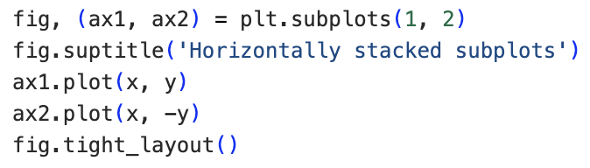
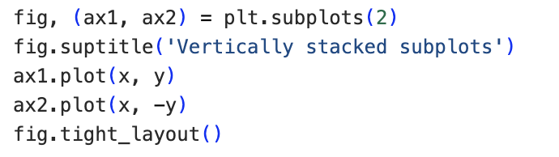
Stacking
Notes:
Now we’ve done that, the first thing we’re going to look at is plotting stacked subplots. Subplots can be stacked horizontally, vertically or both. Subplots stacked horizontally share the same row, whereas subplots stacked vertically share the same column.
Here, we plot two subplots. We use the first line of code to call the individual subplots assigned to their respective locations in the larger figure (in this case, ax1 and ax2) assigned to a larger, single figure name fig. The function subplots allows us to define the number of rows and columns. So, for horizontal stacking this is one row and two columns, whereas for vertical stacking, we just define the number of rows as two, leaving columns at the default value of 1. The data is then plotted for each subplot using the function plot following the respective axis name and a period. The last line of code ensures that the subplot parameters are adjusted so that the subplots fit into the figure area neatly.

Slide 4
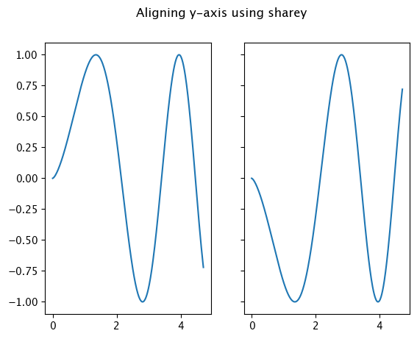
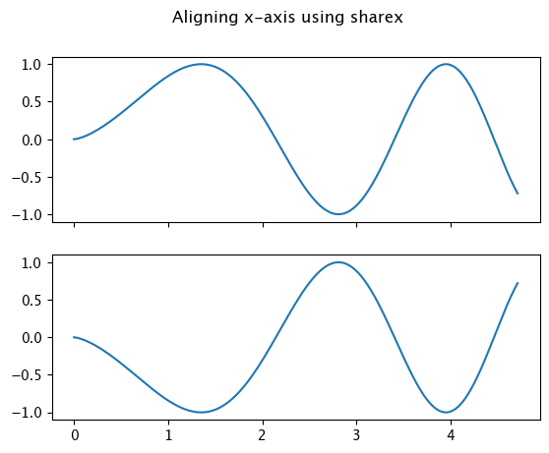
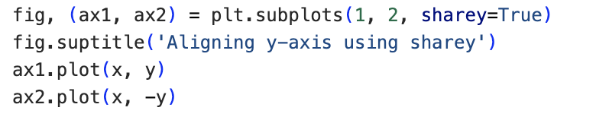
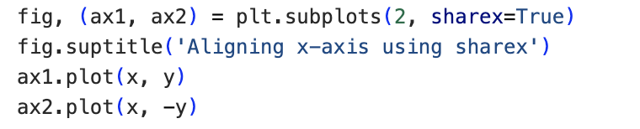
Shared Axes
Notes:
Further to stacking these subplots, we might also want to align the axis along which they are stacked, which we do within the subplots function using the parameter share followed by the axis of choice set to True. As in this example, for horizontally stacked subplots, we would want to share the y-axis, so we use the parameter sharey set to True. For vertically stacked subplots, we would want to share the x-axis, so we use the parameter sharex set to True.
Now earlier, I mentioned that we might want to stack along both the horizontal and vertical axes. So how would we do this?

Slide 5
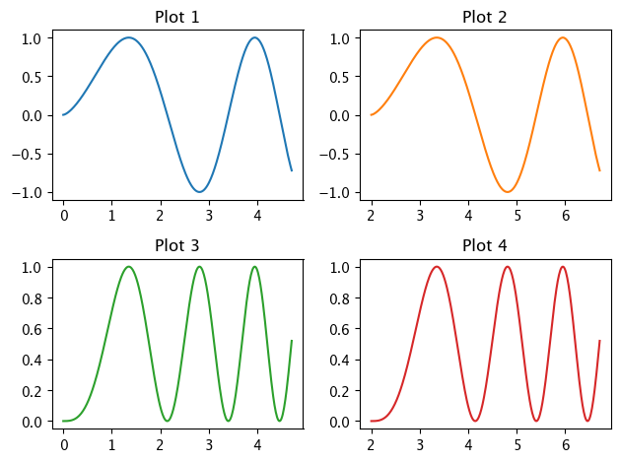
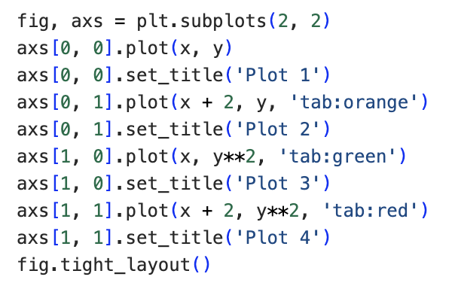
Stacking n x n
Notes:
In this example, we are plotting four subplots in a two-by-two arrangement. Here, each subplot is accessed using their row and column location, starting from zero. So, Plot 1 is accessed using row 0 and column 0, Plot 2, using row 0 and column 1, Plot 3 using row 1 and column 0, and Plot 4 using row 1 and column 1. Data is plotted as before, and we use the string ‘tab, colon, colour’ to set a different colour for each subplot.

Slide 6
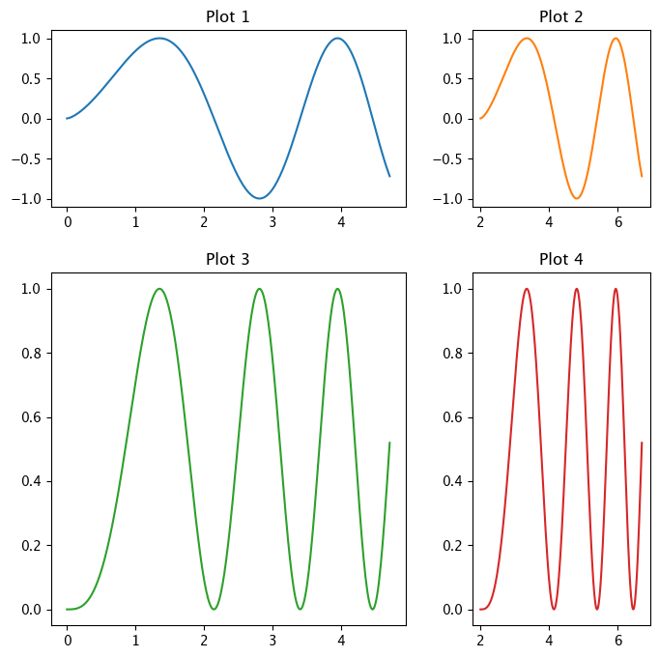
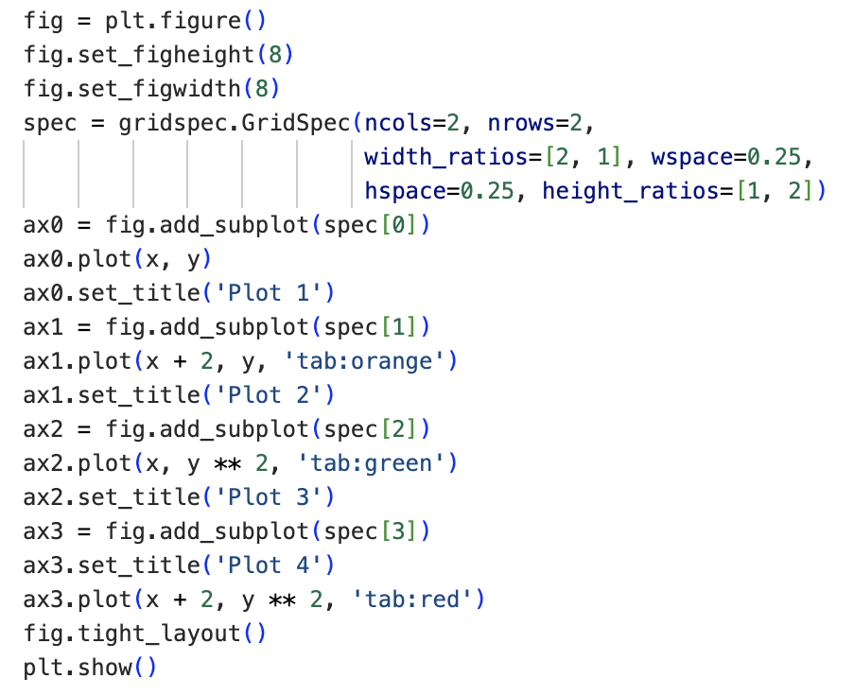
Different Sizes
Notes:
Now, on our final slide for this tutorial, we look at how we might plot an n-by-n arrangement of subplots where each plot is of a different size.
For this, we need to use the matplotlib function gridspec.
First, we must create a plot for the whole figure, setting the height and width. We then use gridspec to define the number of rows and columns. Here, using the width and height ratios parameters, we make it so that the subplots in the first column are twice the width of those in the second column, and the subplots in the second row are twice the height of those in the first row. We then add the four subplots to the larger figure using the function add_subplot(), assigning each a unique callable name. Note that, in this example, when we set the location of each subplot, we access these locations using a single coordinate from zero to three.
Finally, we use the show() function to display the figure.

Slide 7
Replot the figure on the previous slide with the following modifications:
Plots 1 & 2 should be twice the height of plots 3 & 4.
Plots 1 & 3 should be half the width of plots 2 & 4.
Plots 1 & 3 and 2 & 4 should share the same x-axis.
Plots 1 & 2 and 3 & 4 should share the same y-axis.
The plots should be recoloured as follows:
Plot 1 – Orange
Plot 2 – Red
Plot 3 – Pink
Plot 4 – Purple
Challenge Yourself
Notes:
And that’s your second lesson on plotting complete. Now we would like to give you the opportunity to challenge yourself by trying the assignment set on this slide.
Answers will be discussed in the following slide, so make sure to pause this video now while you work through the task.

Slide 8
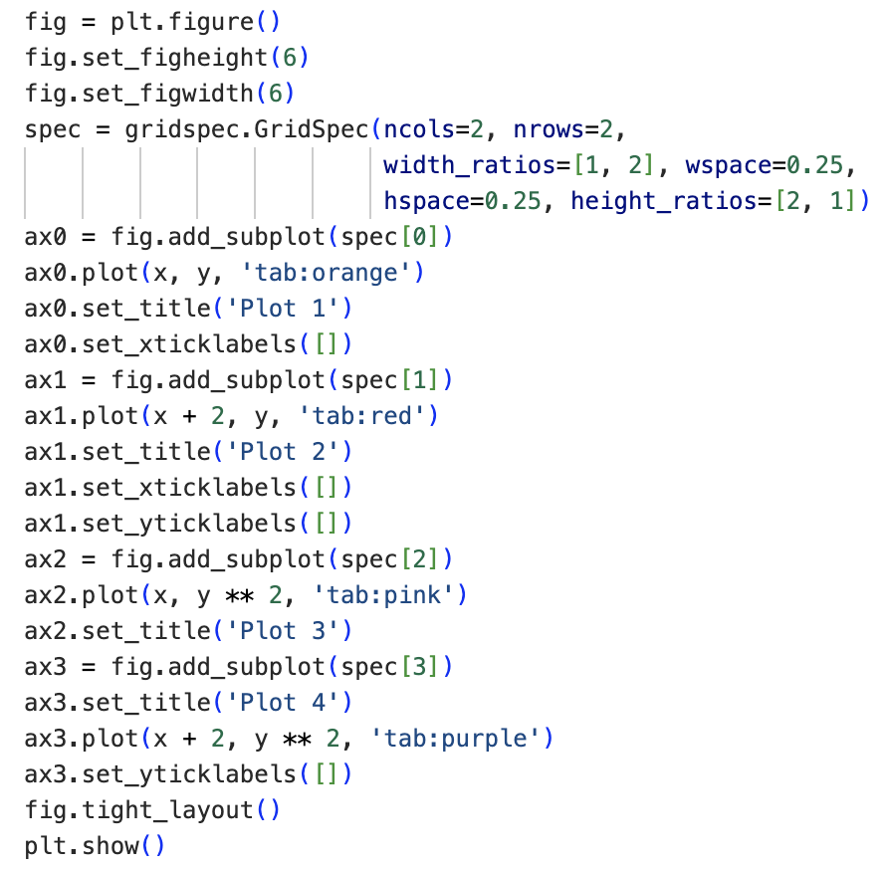

Notes:
We asked you to try replotting the figure on slide 6
so that plots 1 & 2 were twice the height of plots 3 & 4, and plots 1 & 3 were half the width of plots 2 & 4, which we change using the height and width ratios parameters. We also change the overall figure height and width from 8-by-8 to 6-by-6. By removing the xticklabels from the subplots in the first row and the yticklabels from the subplots in the second column, we were also able to share the x-axis between plots 1 & 3 and 2 & 4 and the y-axis between plots 1 & 2 and 3 & 4. Finally, we used the string ‘tab, colon, colour’ to recolour the plots.

Slide 9
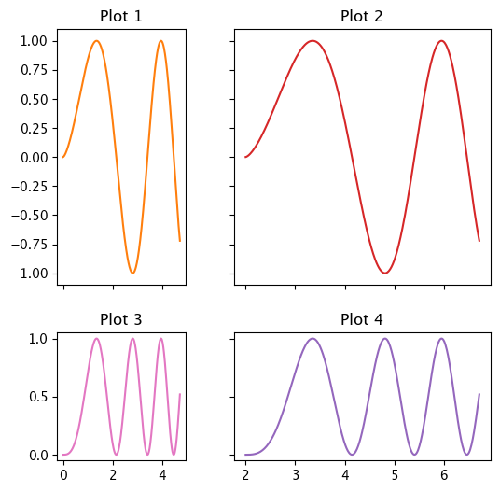
Notes:
The output of this code is as shown here.
How did you find this? If you got it right, congratulations! If not, that’s okay. We don’t always get things right on the first try. There’s still plenty of time to learn, and the teaching staff will be happy to work through any problems with you. Just give us a shout!
Otherwise, see you in the next video.

